Slide 1





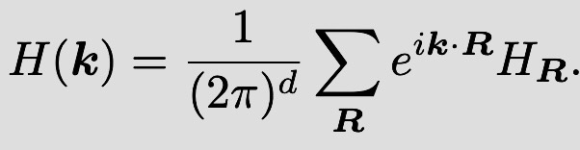

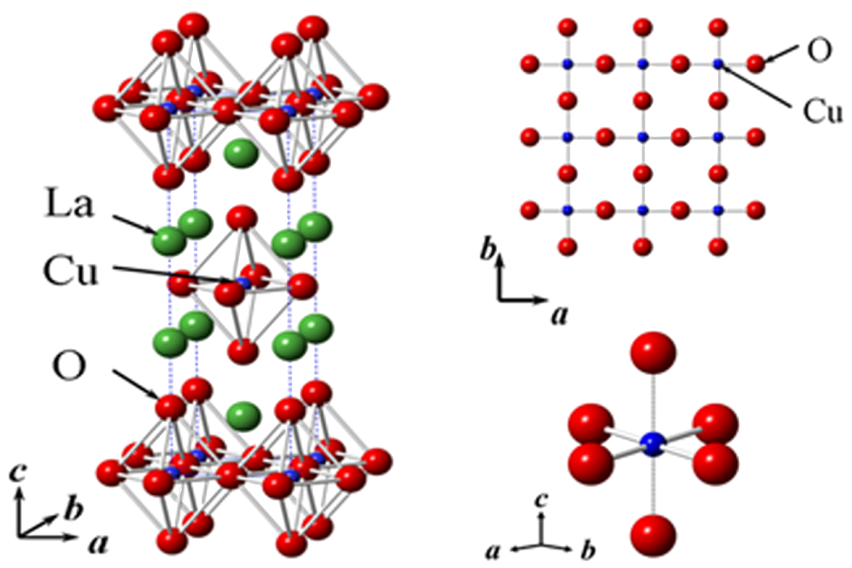

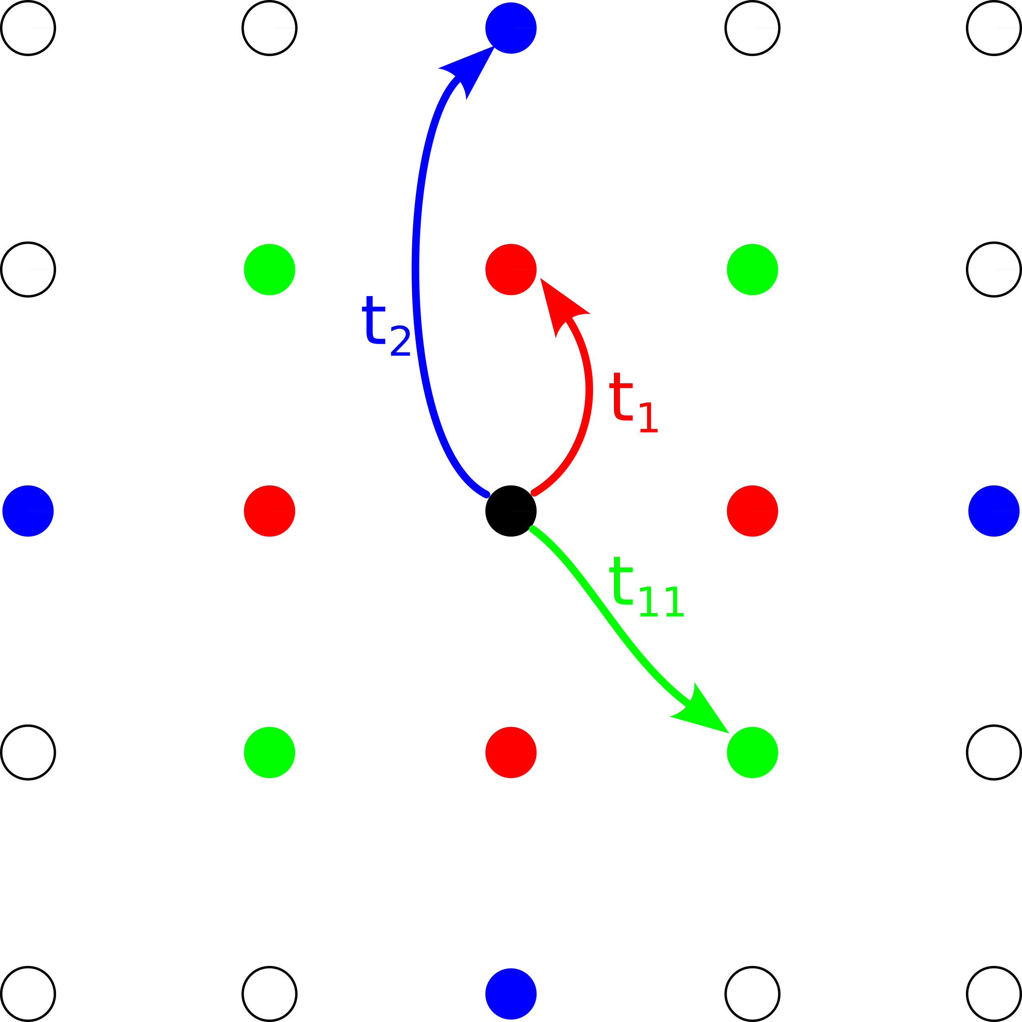
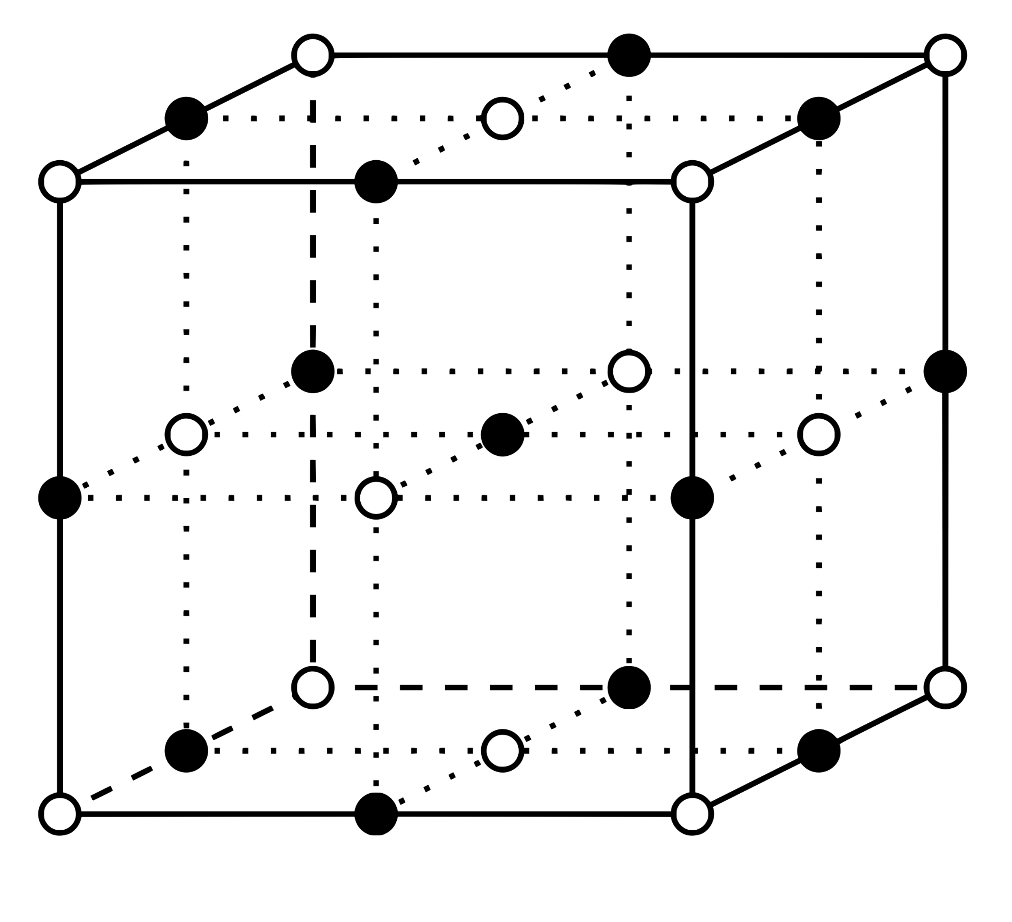



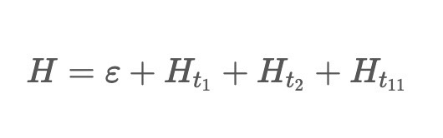
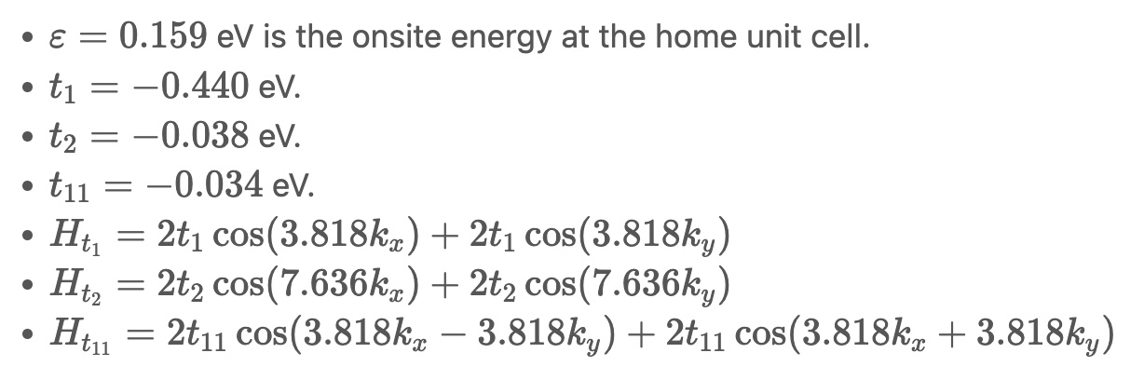
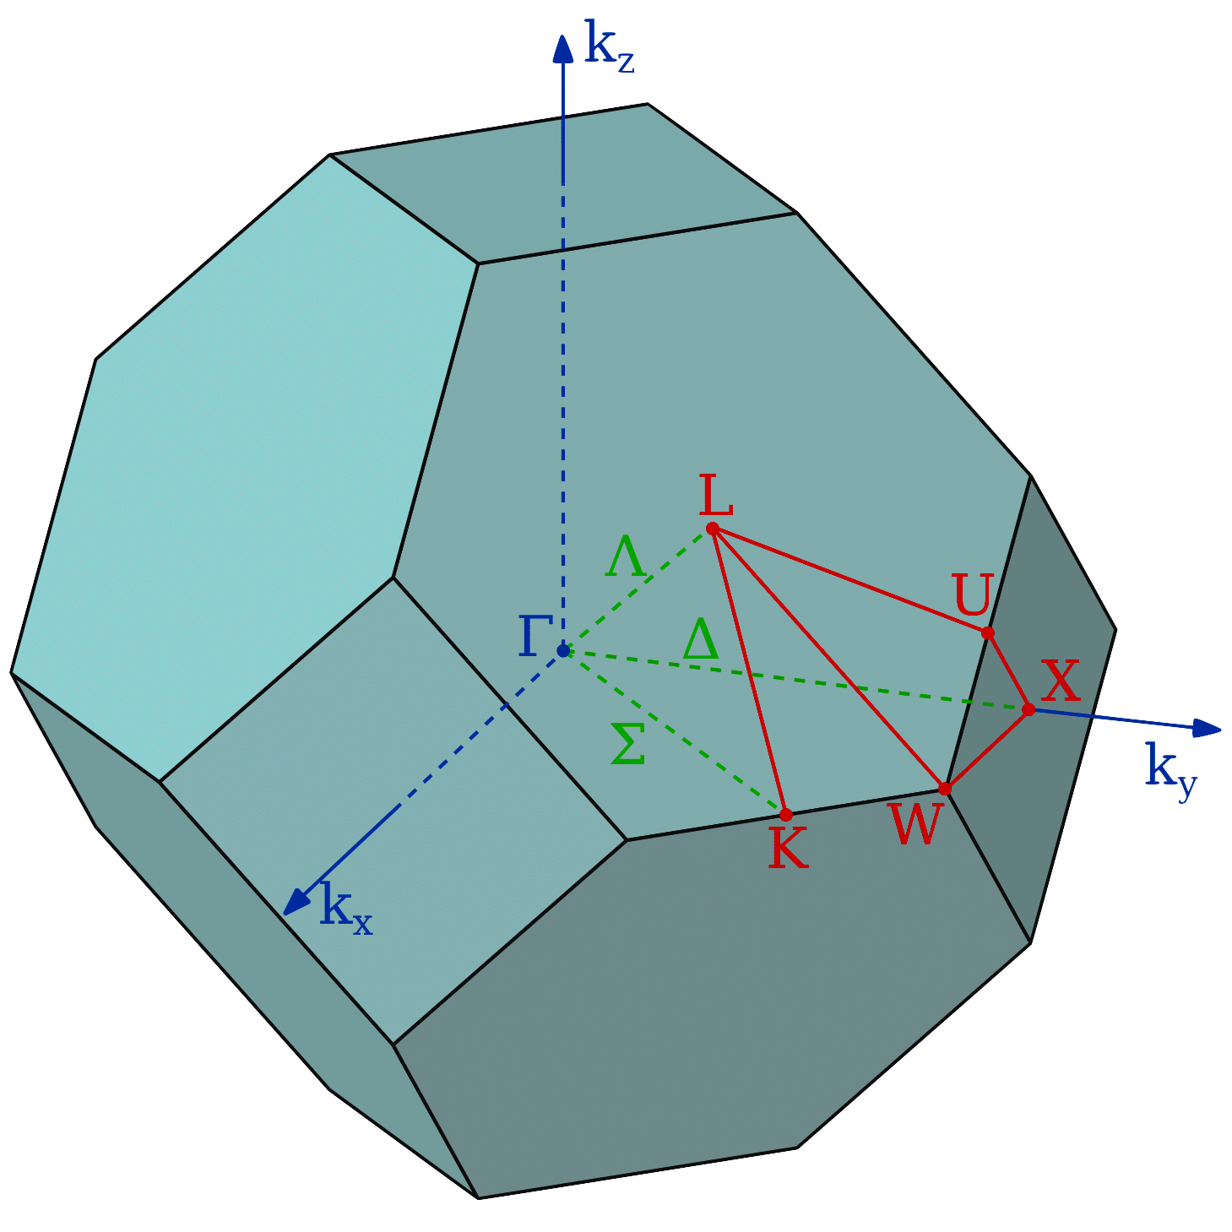
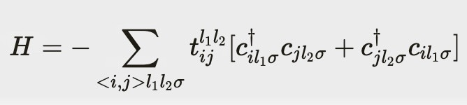
Analytical Tight-Binding Expressions from First Principle Calculations
Collins Kariuki^{1,2}, Sophie Beck², Olivier Gingras²
Department of Physics and Astronomy, Pomona College, Claremont CA 91711¹
Center for Computational Quantum Physics, Flatiron Institute, New York NY 10010²
Abstract
Methods and Data Analysis
The tight-binding (TB) model is used to study the behavior of conductors, semiconductors, and insulators.
Experimental physicists use this model to compare their electronic band structure measurements, e.g., via Angle-Resolved Photoemission Spectroscopy (ARPES), with theoretical predictions.
The aim of my project was to create a function that would accurately compute and generate a succinct and intuitive analytical Hamiltonian output drawing from the TB model’s tractability.
Ab initio (first principles) DFT calculation using e.g., Quantum Espresso
Wannier interpolation using e.g., Wannier90
A simple approximate tight-binding model !!!
Interface with Wannier90 to get hopping parameters and onsite energies.
Reduce hopping parameters by setting cutoffs based on the hopping amplitude norm and hopping distance.
Fourier transform the generated real-space Hamiltonian to a reciprocal space Hamiltonian.
Perform checks on H(k).
Generate analytical (or numerical) Hamiltonian based on the user’s choice of precision and Hamiltonian type
One more thing:
Visualize the similarity between the cutoff and full models by generating a band structure figure.
Background and Introduction
For small systems with few electrons, exact methods like configuration interaction can be employed to calculate the accurate many-electron wavefunction.
For systems of a few 100–1000 atoms, DFT can be employed to find the ground state density and energy of the interacting system without explicitly calculating the many-electron wavefunction.
In larger systems of 10,000 or more atoms, we adopt a semi-empirical approach, including adjustable parameters to match experimental observations.
Lowering the hopping norm cutoff makes the model resemble the full Wannier90 model more closely, as it involves fewer hopping parameters.
Conclusions
Ab initio DFT calculations provide electronic properties and structures. Wannier90 generates Maximally Localized Wannier Functions through Wannier interpolation.
We developed a function that generates a succinct analytical TB Hamiltonian in k-space. Users can customize the Hamiltonian's appearance and precision, aiding symmetrical hopping amplitude verification. Additionally, our function is compatible with both 2D (hopping in a plane) and 3D cases, providing versatility in modeling.
The choice of hopping norm cutoff is crucial. Too high and important hopping parameters may be excluded, leading to a great mismatch with the full Wannier90 model. Too low, and insignificant terms may clutter the Hamiltonian. To address this, we offer users the option to generate a band structure for cutoff comparison.
Our work will be included in the Center for Computational Quantum Physics TRIQS (Toolbox for Research on Interacting Quantum Systems) package.
Additionally, we developed an interactive tutorial providing a step-by-step guide to using our function and generating comparative band structures.
Results
If you model electrons as tightly bound to atoms, you get the TB model which assumes that main electronic behavior arises from interactions between neighboring atoms, where electrons hop between atomic orbitals through tunneling or wavefunction overlap.
The TB model is a minimal model that serves as a foundation for studying electron behavior in metals, including the origins of magnetism and superconductivity:
For theorists, it reduces the number of parameters, from which they can study the effects of the parameters separately.
For experimentalists, it’s useful for a one-body description of the electronic structure. Therefore, if they can understand their data by using a simple representation like a TB model, their data can be understood simply.
An analytical TB model with a restricted number of parameters can help experimentalists fit their data.
The TB Hamiltonian:
The TB model doesn't consider everything about the electrons but focuses on the electron’s hopping behavior, captured by t.
We tested our function on various cuprates, including La₂CuO₄ (lanthanum cuprate), a superconductor. This system has one orbital and one site per unit cell.
By Great Stellated Dodecahedron
By Hideo Hosono et al.
By Olivier Gingras
Analyzing the Wannier90 output files with a hopping amplitude norm cutoff of 0.038 eV yielded the following analytical Hamiltonian:
Where:
References
A. Einstein, “Concepts in Condensed Matter Physics: Tutorial I,” (n.d.).
J. Kaye, S. Beck, A. Barnett, L. Van Muñoz, and O. Parcollet, “Automatic, high-order, and adaptive algorithms for Brillouin zone integration,” (2023).
M.P. Marder, Condensed Matter Physics, 2nd ed (Wiley, Hoboken, N.J, 2010).
M. Roy, “The Tight Binding Method,” Rutgers University 5, 57 (2015).
R. Scalettar, “An Introduction to the Hubbard Hamiltonian,” Quantum Materials: Experiments and Theory 6, (2016).
H. Zhang, T. Pincelli, C. Jozwiak, T. Kondo, R. Ernstorfer, T. Sato, and S. Zhou, “Angle-resolved photoemission spectroscopy,” Nat Rev Methods Primers 2(1), 1–22 (2022).
The analytical Hamiltonian is a 1-by-1 matrix since orbital hopping occurs only within one orbital for lanthanum cuprate.
The Hamiltonian efficiently captures essential features of the crystalline material, such as the onsite energies of the home unit cell and the symbolic hopping amplitudes.
By Inductiveload
Acknowledgements
We would like to thank Alexander Hampel and Nils Wentzell for their help in integrating our function and its tutorial into the TRIQS package.
We would like to thank the Simons Foundation and the National Society of Black Physicists for their cooperation in enabling this internship opportunity, and thus the research, to happen
Notes:
Two models are important when characterizing electron behavior in a solid by calculating band structure:
The nearly free electron model.
The tight-binding (TB) model.
In even larger systems with around 10,000 or more atoms, self-consistent DFT calculations are no longer feasible to fully account for the interaction. Instead, we adopt a semi-empirical approach, including interaction effects through adjustable parameters to match experimental observations, and calculate the band structure and approximate single-particle states.
Ab initio DFT calculations provide electronic properties and structures. Wannier90 generates Maximally Localized Wannier Functions through Wannier interpolation because we only consider local interactions with electrons that are closely bound to their atoms within the TB model framework.
One example is my friend, who does ADMR [Angle-Dependent Magnetoresistance] on strange metals. Well, strange metals are highly correlated, but somehow he can use his ADMR data to find the well-defined Fermi surface that explains the data found.
The model’s semi-empirical approach coupled with its mathematical tractability can aid us in getting a simple analytical Hamiltonian output.

Slide 2
Analytical Tight-Binding Expressions from First Principle Calculations
Collins Kariuki^{1,2}, Sophie Beck², Olivier Gingras²
Department of Physics and Astronomy, Pomona College, Claremont CA 91711¹
Center for Computational Quantum Physics, Flatiron Institute, New York NY 10010²
Abstract
Methods and Data Analysis
The tight-binding (TB) model is used to study the behavior of conductors, semiconductors, and insulators.
Experimental physicists use this model to compare their electronic band structure measurements, e.g., via Angle-Resolved Photoemission Spectroscopy (ARPES), with theoretical predictions.
The aim of my project was to create a function that would accurately compute and generate a succinct and intuitive analytical Hamiltonian output drawing from the TB model’s tractability.
Ab initio (first principles) DFT calculation using e.g., Quantum Espresso
Wannier interpolation using e.g., Wannier90
A simple approximate tight-binding model !!!
Interface with Wannier90 to get hopping parameters and onsite energies.
Reduce hopping parameters by setting cutoffs based on the hopping amplitude norm and hopping distance.
Fourier transform the generated real-space Hamiltonian to a reciprocal space Hamiltonian.
Perform checks on H(k).
Generate analytical (or numerical) Hamiltonian based on the user’s choice of precision and Hamiltonian type
One more thing:
Visualize the similarity between the cutoff and full models by generating a band structure figure.
Background and Introduction
For small systems with few electrons, exact methods like configuration interaction can be employed to calculate the accurate many-electron wavefunction.
For systems of a few 100–1000 atoms, DFT can be employed to find the ground state density and energy of the interacting system without explicitly calculating the many-electron wavefunction.
In larger systems of 10,000 or more atoms, we adopt a semi-empirical approach, including adjustable parameters to match experimental observations.
Lowering the hopping norm cutoff makes the model resemble the full Wannier90 model more closely, as it involves fewer hopping parameters.
Conclusions
Ab initio DFT calculations provide electronic properties and structures. Wannier90 generates Maximally Localized Wannier Functions through Wannier interpolation.
We developed a function that generates a succinct analytical TB Hamiltonian in k-space. Users can customize the Hamiltonian's appearance and precision, aiding symmetrical hopping amplitude verification. Additionally, our function is compatible with both 2D (hopping in a plane) and 3D cases, providing versatility in modeling.
The choice of hopping norm cutoff is crucial. Too high and important hopping parameters may be excluded, leading to a great mismatch with the full Wannier90 model. Too low, and insignificant terms may clutter the Hamiltonian. To address this, we offer users the option to generate a band structure for cutoff comparison.
Our work will be included in the Center for Computational Quantum Physics TRIQS (Toolbox for Research on Interacting Quantum Systems) package.
Additionally, we developed an interactive tutorial providing a step-by-step guide to using our function and generating comparative band structures.
Results
If you model electrons as tightly bound to atoms, you get the TB model which assumes that main electronic behavior arises from interactions between neighboring atoms, where electrons hop between atomic orbitals through tunneling or wavefunction overlap.
The TB model is a minimal model that serves as a foundation for studying electron behavior in metals, including the origins of magnetism and superconductivity:
For theorists, it reduces the number of parameters, from which they can study the effects of the parameters separately.
For experimentalists, it’s useful for a one-body description of the electronic structure. Therefore, if they can understand their data by using a simple representation like a TB model, their data can be understood simply.
An analytical TB model with a restricted number of parameters can help experimentalists fit their data.
The TB Hamiltonian:
The TB model doesn't consider everything about the electrons but focuses on the electron’s hopping behavior, captured by t.
We tested our function on various cuprates, including La₂CuO₄ (lanthanum cuprate), a superconductor. This system has one orbital and one site per unit cell.
By Great Stellated Dodecahedron
By Hideo Hosono et al.
By Olivier Gingras
Analyzing the Wannier90 output files with a hopping amplitude norm cutoff of 0.038 eV yielded the following analytical Hamiltonian:
Where:
References
A. Einstein, “Concepts in Condensed Matter Physics: Tutorial I,” (n.d.).
J. Kaye, S. Beck, A. Barnett, L. Van Muñoz, and O. Parcollet, “Automatic, high-order, and adaptive algorithms for Brillouin zone integration,” (2023).
M.P. Marder, Condensed Matter Physics, 2nd ed (Wiley, Hoboken, N.J, 2010).
M. Roy, “The Tight Binding Method,” Rutgers University 5, 57 (2015).
R. Scalettar, “An Introduction to the Hubbard Hamiltonian,” Quantum Materials: Experiments and Theory 6, (2016).
H. Zhang, T. Pincelli, C. Jozwiak, T. Kondo, R. Ernstorfer, T. Sato, and S. Zhou, “Angle-resolved photoemission spectroscopy,” Nat Rev Methods Primers 2(1), 1–22 (2022).
The analytical Hamiltonian is a 1-by-1 matrix since orbital hopping occurs only within one orbital for lanthanum cuprate.
The Hamiltonian efficiently captures essential features of the crystalline material, such as the onsite energies of the home unit cell and the symbolic hopping amplitudes.
By Inductiveload
Acknowledgements
We would like to thank Alexander Hampel and Nils Wentzell for their help in integrating our function and its tutorial into the TRIQS package.
We would like to thank the Simons Foundation and the National Society of Black Physicists for their cooperation in enabling this internship opportunity, and thus the research, to happen
Notes:
Two models are important when characterizing electron behavior in a solid by calculating band structure:
The nearly free electron model.
The tight-binding (TB) model.
In even larger systems with around 10,000 or more atoms, self-consistent DFT calculations are no longer feasible to fully account for the interaction. Instead, we adopt a semi-empirical approach, including interaction effects through adjustable parameters to match experimental observations, and calculate the band structure and approximate single-particle states.
Ab initio DFT calculations provide electronic properties and structures. Wannier90 generates Maximally Localized Wannier Functions through Wannier interpolation because we only consider local interactions with electrons that are closely bound to their atoms within the TB model framework.
One example is my friend, who does ADMR [Angle-Dependent Magnetoresistance] on strange metals. Well, strange metals are highly correlated, but somehow he can use his ADMR data to find the well-defined Fermi surface that explains the data found.
The model’s semi-empirical approach coupled with its mathematical tractability can aid us in getting a simple analytical Hamiltonian output.

